Slide 1
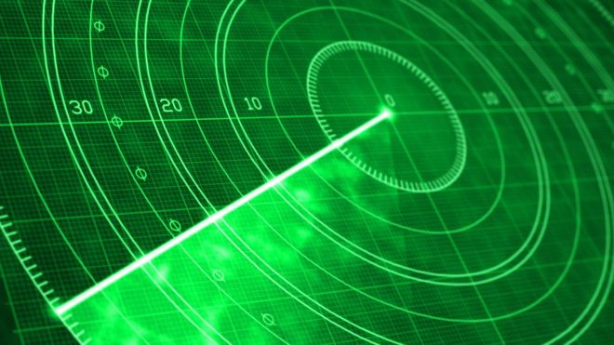
SOUND BASED RADAR
An application for the visually challenged

Slide 2
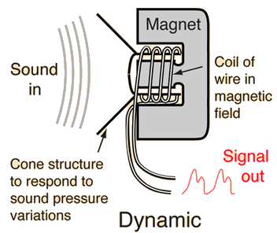
PRINCIPLE
ECHO - A very basic principle of sound reflection from an object on being struck with sound is explored
Dynamic Microphone and Speaker -
Sound moves cone and attached coil of wire in field of magnet, generator effect produces a voltage that images the sound pressure, that can be amplified
It was important to choose a dynamic and not a condenser microphone

Slide 3
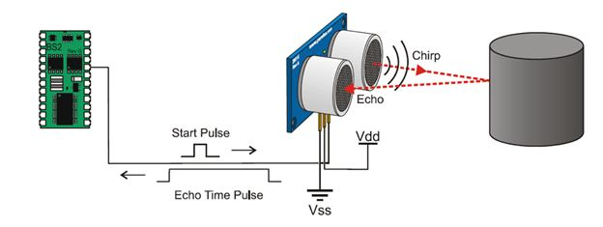
PRINCIPLE - ULTRASONIC SENSORS
Emits short, high-frequency sound pulses at regular intervals
Pulses propagate in the air at the velocity of sound. If they strike an object, then they are reflected back as echo signals to the sensor
Sensor computes the time-span between emitting the signal and receiving the echo based on which we can estimate its distance

Slide 4
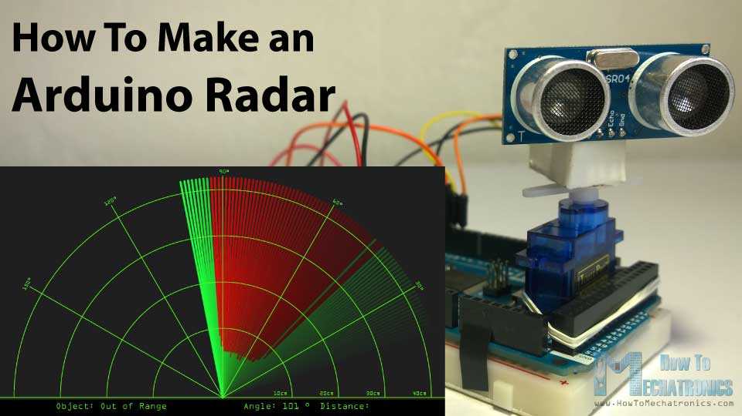
RADAR IS ACHIEVED
The sensor is mounted on a servo motor, controlled with arduino to provide range of detection.
Sensor scans the area for presence of an object, which is displayed on screen

Slide 5
RECEIVING OF SIGNAL
Signal generated gives location of objects which is transmitted to a python file
Python file processes the signal and sends appropriate sound to be played on headphones.

Slide 6
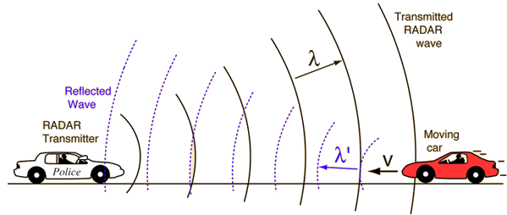
APPLICATIONS and IMPROVEMENTS
This can be useful aid to blind people
Police for surveillance and Professional Spectator Sports
Collision Avoidance Systems in cars
Doppler Radar
Measurement - Velocity data about objects at a distance wrt radar
Principle - Object's motion has altered the frequency of the returned signal
Notes:
Professional Spectator Sports - bowling speed, athletes etc.

Slide 7
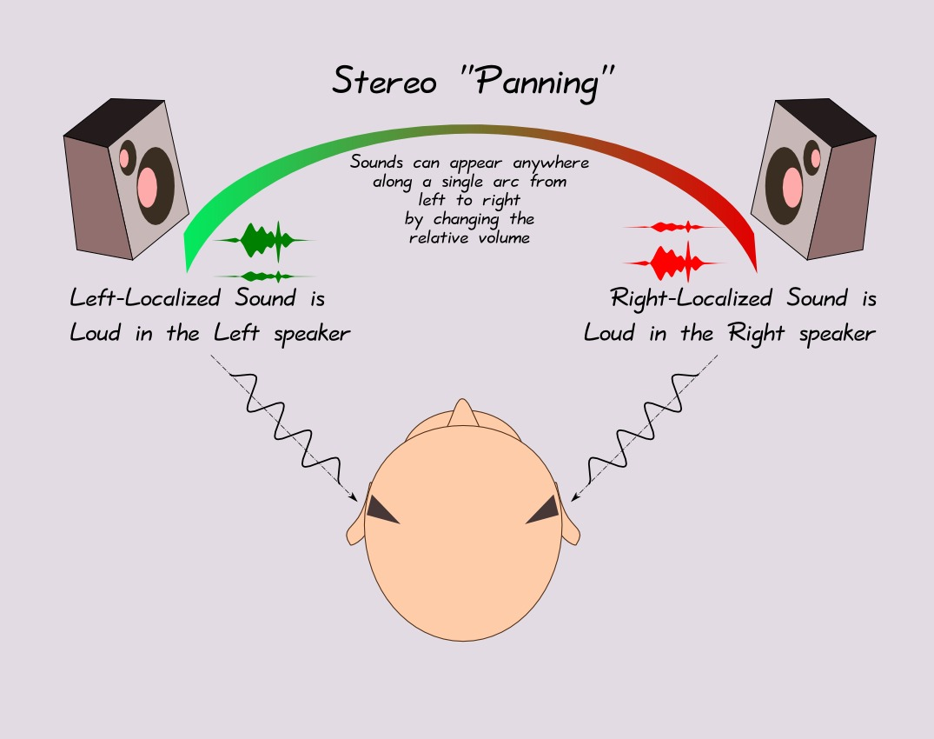
For the visually challenged
In order to ‘see’, they need to know the location of the closest obstacle
In polar coordinates, they need R and θ
Our solution - to give them this information using sound
R - Magnitude of sound given through headphones
Θ - Direction of sound - using a stereo headphone set

